Slide 1
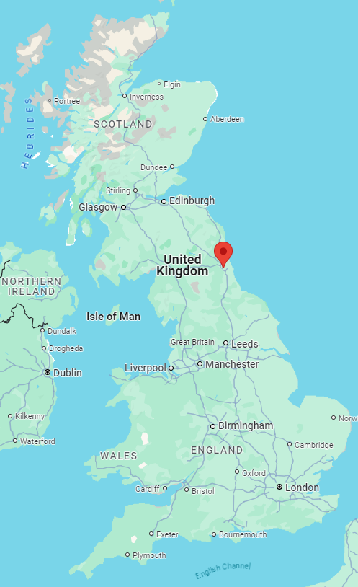
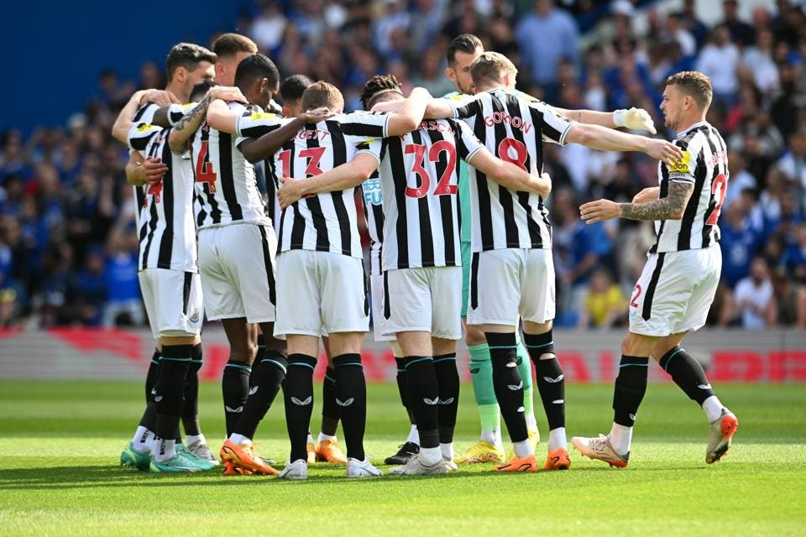
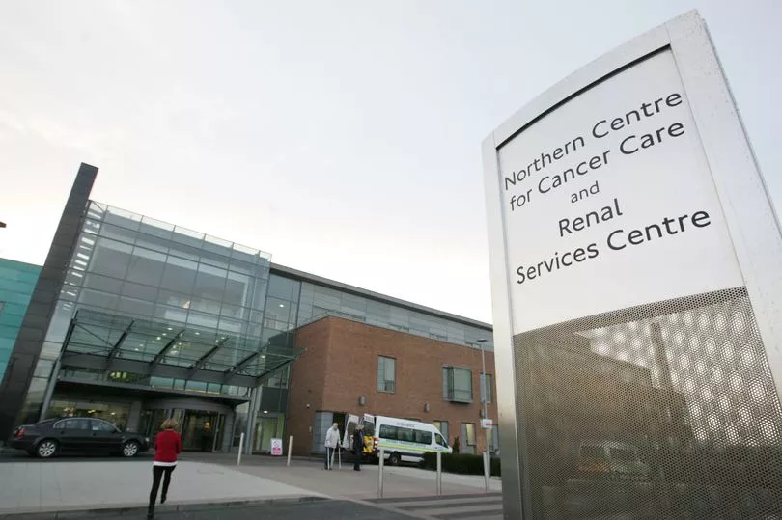

Ευτυχία Δουγένη
Clinical Scientist and
Medical Physics Expert
Imaging Physics & Radiation safety
Newcastle upon Tyne Hospitals
National Health System (NHS)
e.dougeni@nhs.net
My role as a physicist:
Advice on compliance with Legislation (IRMER 2017)
Commissioning and testing diagnostic x-ray equipment
Advice on new equipment
Optimisation-advice on new techniques
Patient dosimetry-Local Diagnostic Ref levels (LDRLs)
Radiological Incidents e.g. wrong patient exposed-
Teaching at University-Msc on Med Physics
Teaching and training of medical staff/colleagues
Ethics and Research
Note: NOT a Radiation Protection Advisor (RPA)
Continuous professional development (CPD)
Salary NHS BAND 7 – 8A
Holidays 27-33 days
Our Regional Department:
Cover about 700 units- up to 3 hours drive
200 general radiographic units
200 dental
170 C-arm mobiles
60 Mammography units (9 mobile)
50 CT scanners
20 DEXA units

Slide 2
Master in Medical Physics
Band 6
Clinical Scientist
Band 7
Medical Physics Expert (MPE) OR Radiation Protection Advisor (RPA)
Band 8a
Scientific training Program (STP)
3 years- Employed by NHS-Band 6
Route 1: Direct entry- Harder
Route 2: Indirect- In service STP-existing NHS staff-easier
Registration with Health and Care Professions Council (HCPC)
Route 1: Direct- completing the Msc
Route 2: Indirect- International applicants- build experience and Portfolio evidence
e.g. 1 to 4 years
Different roles:
MPE: Safety of Patient focused
Ionising Radiation (Medical Exposures) Regulations 2017-IRMER
RPA: Safety of Staff and public focused
Ionising Radiation Regulations 2017-IRR
Band 6 | £37.338 | £44.462
Band 7 | £46.148 | £52.809
Band 8 | £53.755 | £60.504
Other topics: Brexit, Current vacancies, Mailing list, interviews, Lifestyle
Useful Links
NHS jobs https://www.jobs.nhs.uk/candidate
Health Jobs HealthJobsUK | trac.jobs
Mailing list fro jobs email me to add you or go to https://www.jiscmail.ac.uk/cgi-bin/webadmin?SHOWTPL=HELP-SUBEDIT&L=medical-physics-engineering
Health and Care Professions Council https://www.hcpc-uk.org/
Apply for NHS visa https://www.gov.uk/health-care-worker-visa/apply-from-outside-the-uk
Legislation and guidance
IR(ME)R 2017 https://www.legislation.gov.uk/uksi/2017/1322/contents/made
IR(ME)R 2017 Guidance https://www.gov.uk/government/publications/breast-screening-guidance-on-implementation-of-ionising-radiation-medical-exposure-regulations-2017/guidance-for-the-implementation-of-the-irmer-regulations-2017
IRR Legislation https://www.legislation.gov.uk/uksi/2017/1075/contents
IRR guidance https://www.hse.gov.uk/pubns/books/l121.htm
Scientist training Program –Masters/STP https://nshcs.hee.nhs.uk/programmes/stp/
BBC weather https://www.bbc.co.uk/weather/6296611

