Slide 1
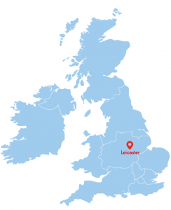
Sofia Kordolaimi
Lead Radiotherapy Clinical Scientist, MPE
University Hospitals of Leicester
Email: sofia.kordolaimi@uhl-tr.nhs.uk

Slide 2
My Work Routine
Practical application and translation of the legislation into clinical practice
Audits
Provide expert advice in non-standard cases/ troubleshooting
Investigation of incidents
Leading projects
Provide advice to employers
Line management of other staff
Preparation of reports and attending meetings
Delivery of training/ CPD
Introducing new techniques and technologies into clinical routine
Radiobiology calculations
Review of RT imaging procedures & optimisation of imaging protocols
Evaluation & commissioning of RT equipment
Trials
Routine clinical work (QA, plan checking, PSQA)

Slide 3
Useful links
Scientist Training Programme (STP): https://nshcs.hee.nhs.uk/programmes/stp/
Alternative to STP scheme (Route 2): https://assclinsci.org/
HCPC registration (mutual recognition path): https://www.hcpc-uk.org/registration/getting-on-the-register/international-applications/
MPE certification scheme: https://www.rpa2000.org.uk/mpe-recognition-scheme/
Higher Specialist Scientist Training programme: https://nshcs.hee.nhs.uk/programmes/hsst/
Available job posts: https://www.jobs.nhs.uk/

